Slide 1
Introduction to Microsoft Flow
Notes:
This module teaches the essential concepts and visual designer skills required to design and implement flows using triggers, actions and conditions. Students will learn how to configure triggers to build flows that can be scheduled, executed in response to external events or run on demand using a button on a mobile device. The module explains how data within a flow is propagated from step to step and discusses various design techniques for managing state within the lifetime of a flow. Students will also learn how to write complex Flow expressions to retrieve dynamic content, to perform type conversion between strings, numbers and dates and to design flows using loops, variables, arrays and custom objects. The module also introduces students to advanced Flow design techniques including error handling, flow termination and executing steps in parallel.

Slide 2
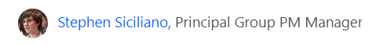
Agenda
Flow Fundamentals
Writing Flow Expressions
Converting Between Types
Working with Arrays
Advanced Techniques
Thanks for coming up with the idea for this session

Slide 3

Deep Dive into PowerApps and Flow
Two action-packed days of building PowerApps and Flows
Getting Started with PowerApps Studio
Designing PowerApps using Advanced Techniques
Building PowerApps for SharePoint Online
Introduction to Microsoft Flow
Designing Flows to Automate an Approval Process
Building PowerApps and Flows for Power BI
Working with the Common Data Service for Apps
Managing Application Lifecycle with PowerApps and Flow
More info
https://www.criticalpathtraining.com
info@criticalpathtraining.com

Slide 4
What is Flow?
Service for automating workflows across other services
Designed by Microsoft for business users more than developers
What can you do with Flow?
Get notifications
Create, copy, update and delete files
Collect and clean data
Automate approvals

Slide 5
Building Blocks of Flow
Flows whether created from a template or from scratch:
Will contain building blocks that work together in certain ways (much like a flowchart)
Building blocks of Flow:
Services - sources and destinations of data in a flow
Triggers - events that start a flow
Actions - tasks accomplished by the flow
Conditions - allow for branching if/then logic in a flow
Loops - for iterating over actions more than once

Slide 6
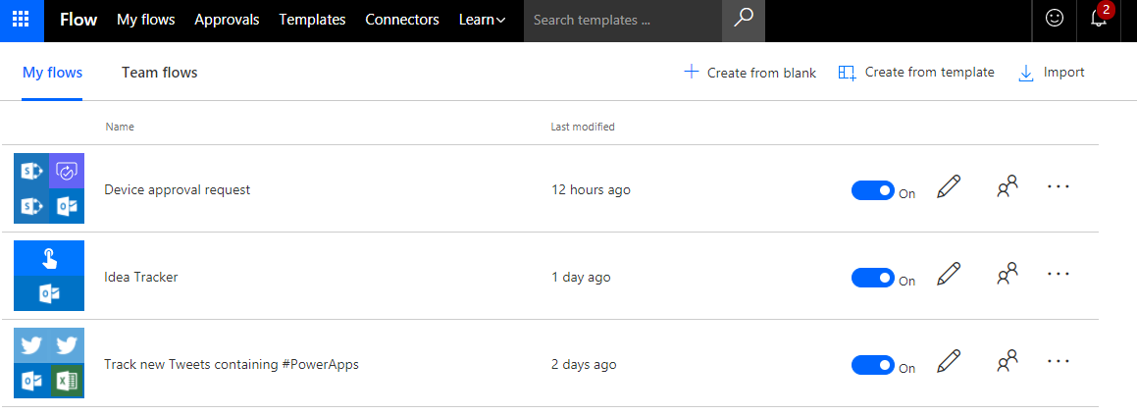
Creating and Managing Flows
Each user has a list of flows
Flows can be shared with or transferred to other users
Two ways to create a new flow
Create from template
Create from blank

Slide 7
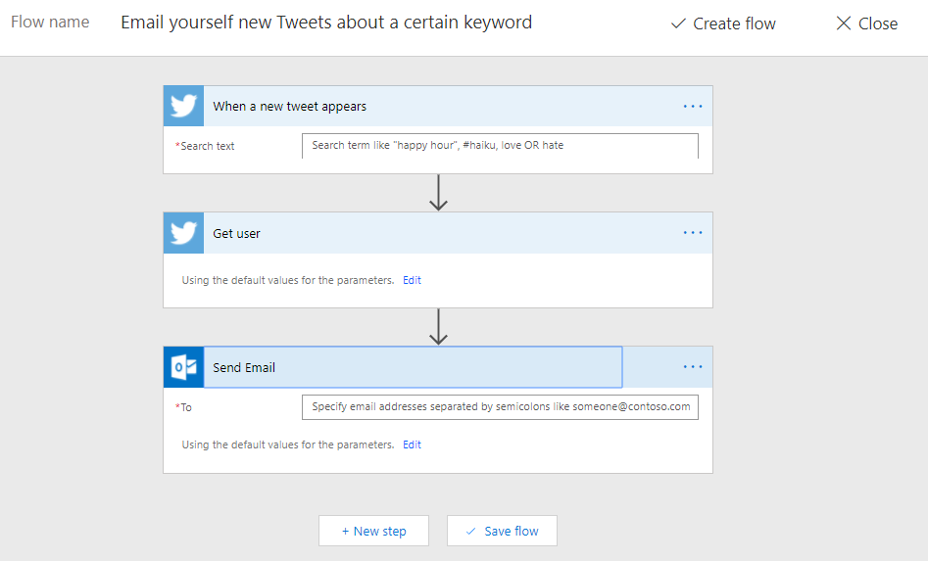
Working with the Flow Designer
Flow Designer provides UI for building flows
You build flows by adding and configuring steps
There are 3 types of steps: triggers, actions or conditions
Rename steps before referencing them in later steps
Trigger
Action
Action

Slide 8
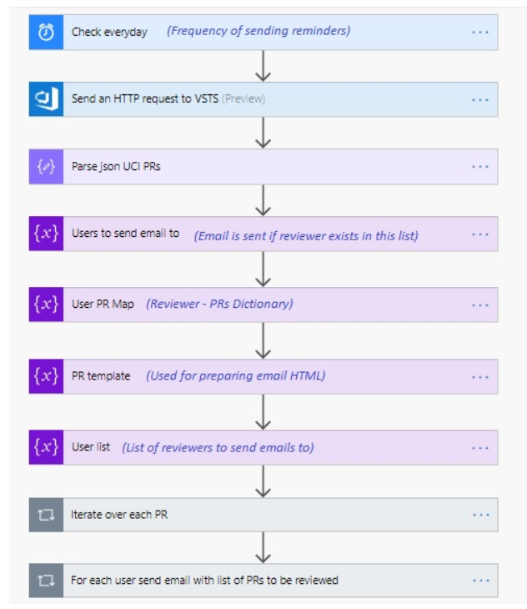
Example Award Winning Flow

Slide 9
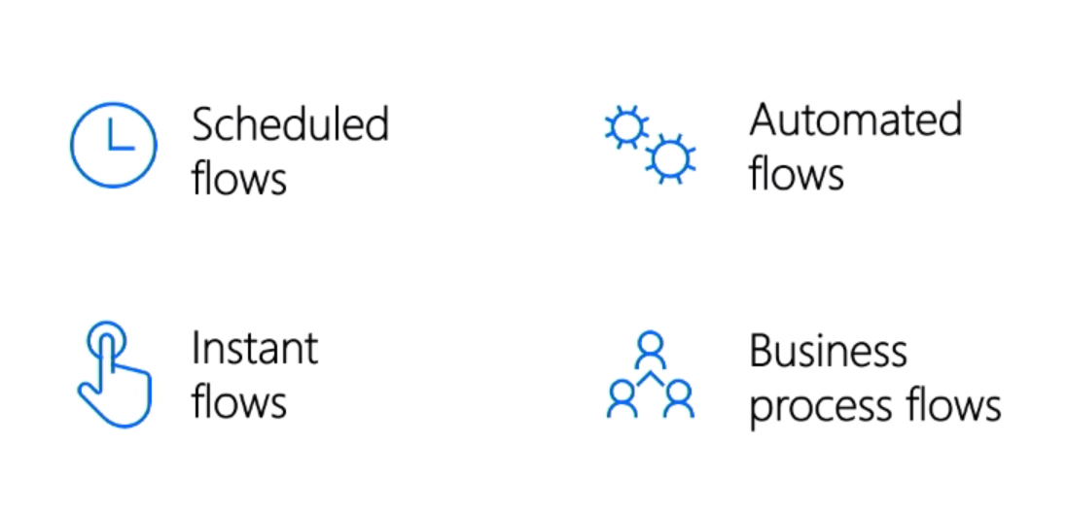
Types of Flows
Automated Flows
Runs when something happens (e.g. new list item)
Scheduled Flows
Runs periodically based on an interval
Instant Flows
Runs when a user clicks a button
Business Process Flows
Integrated with CDS for Apps and Dynamics 365

Slide 10
Changing the Flow Trigger Type

Slide 11
Agenda
Flow Fundamentals
Writing Flow Expressions
Converting Between Types
Working with Arrays
Advanced Techniques

Slide 12
Flowing Data
Data in flows added by steps
Data added in step is available in later steps
Add Dynamic Content select outputs from previous steps
Certain outputs shows up based on types of input and output
Flow
Trigger
Outputs:
File Name
File Size
File Content
Action 1
Inputs:
File Name
File Size
File Content
Outputs:
Title
Count
Action 2
Inputs:
File Name
File Size
File Content
Title
Count

Slide 13
Writing Flow Expressions
Scenarios for writing Flow expressions
Convert types
Perform simple inline calculations
Perform string manipulation
Generate a GUD or a random number
Handling optional values
Writing conditional statements using "If" statements
Working with lists

Slide 14
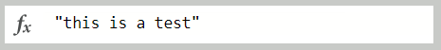
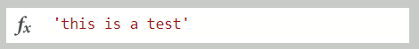
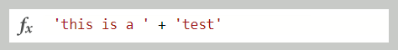
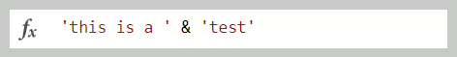
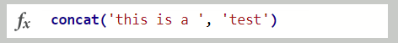
Workflow Definition Language (WDL)
Flow expressions written in Workflow Definition Language
Same language used in Azure Logic Apps
WDL is more powerful yet more complicated than PowerApps
WDL does not overload operators like PowerApps does
WDL requires single quotes instead of double quotes
Invalid: no double quotes
Valid
Invalid : + operator not supported
Invalid : & operator not supported
Valid

Slide 15
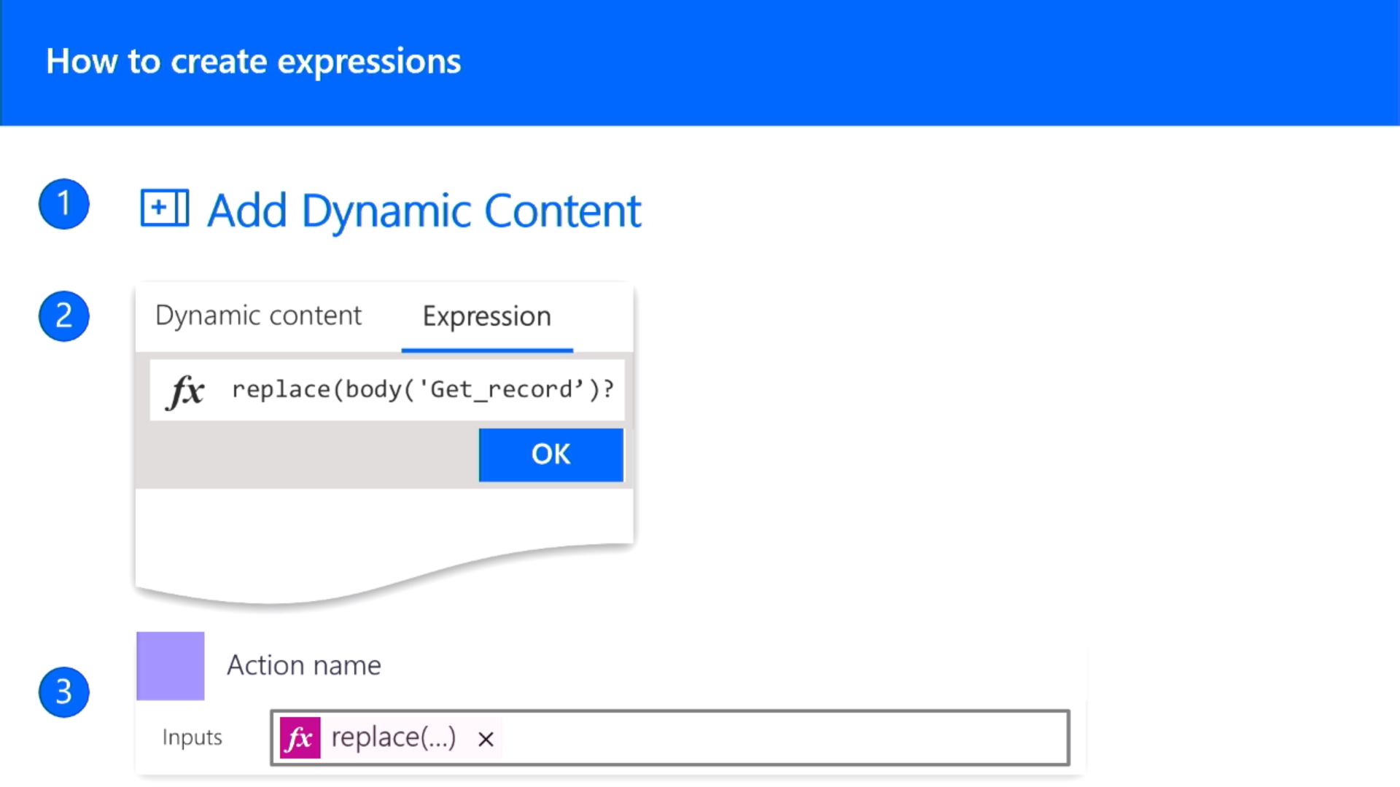
Using the Add Dynamic Content

Slide 16
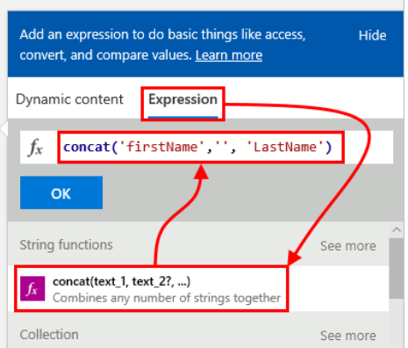
Writing Expressions
Expressions written in fx textbox
Click OK to enter expressions

Slide 17
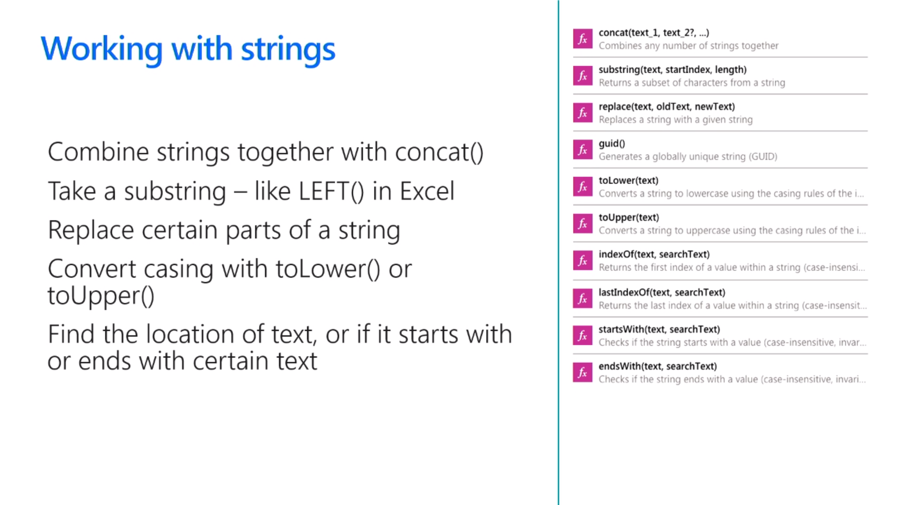
Working with Strings
Parse text together using concat()
Parse out text using substring()
Convert casing using toLower() and toUpper()
Search string using indexOf and startsWith()
Create new GUID identifier using guid()

Slide 18
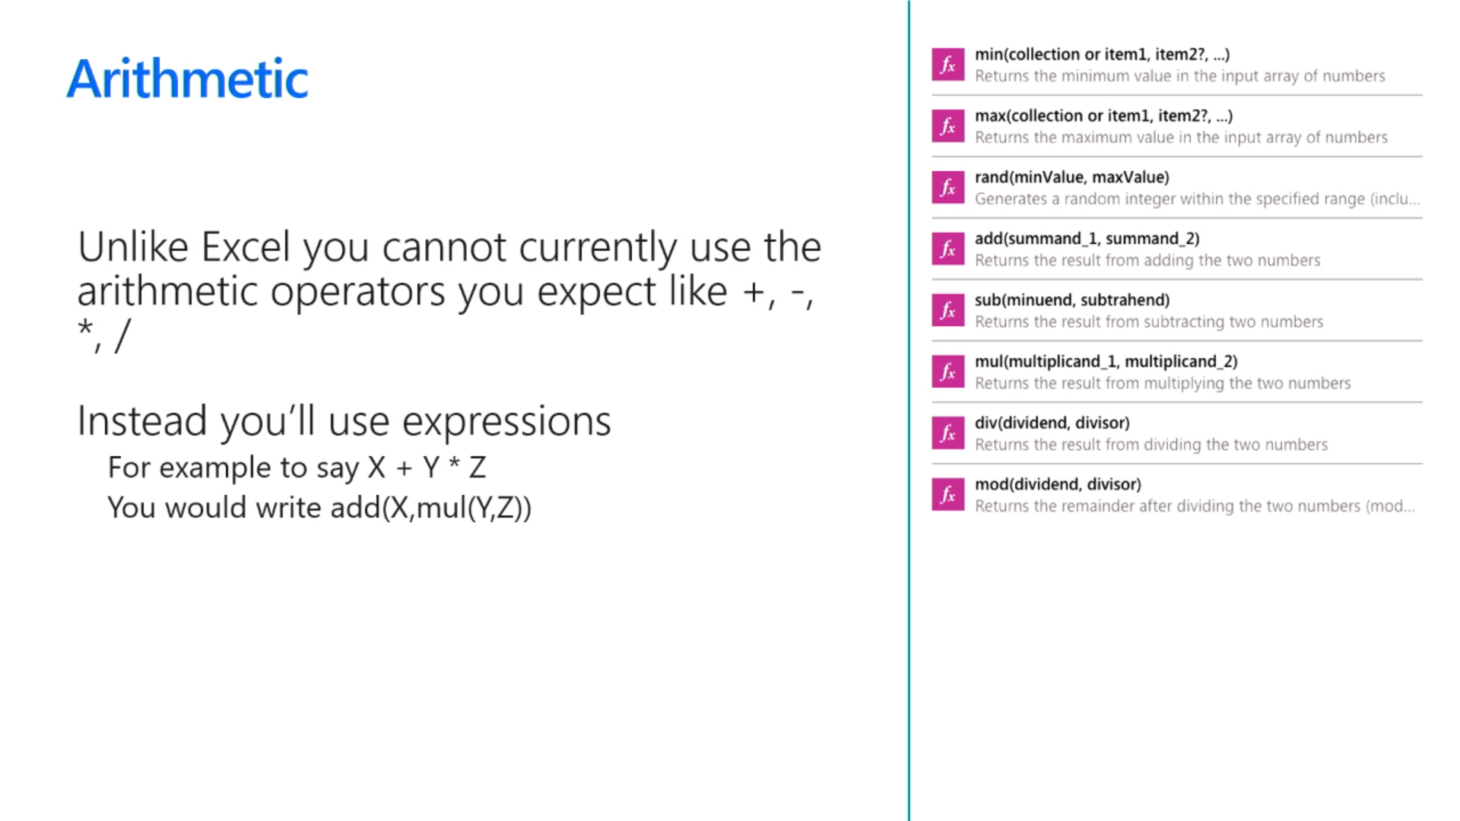
Performing Arithmetic Operations
You cannot use standard arithmetic operators
This includes familiar operators such as +, -, *, /
This does not work: 2 + 2
This works: add(2, 2)

Slide 19
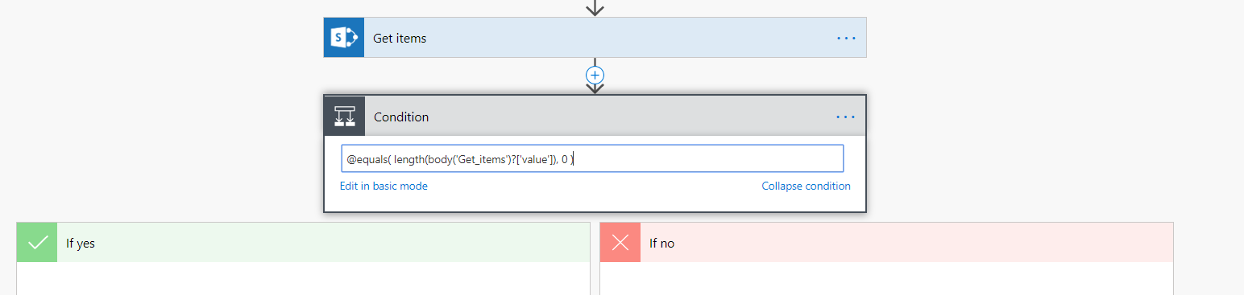
Using Boolean Expressions in a Condition
Do as much as you can in basic mode
Then select Edit in advanced mode
Enter expression as Boolean expression
Unlike in Dynamic Content, you must begin with @

Slide 20
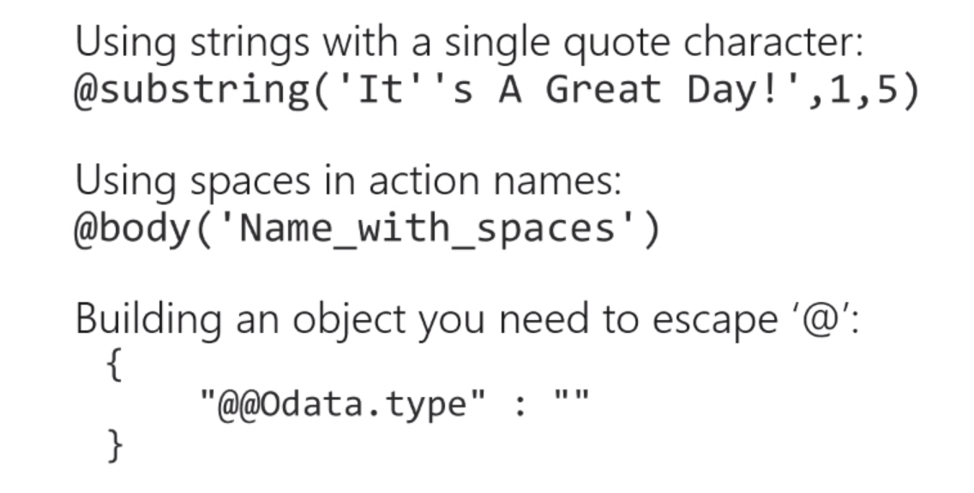
Escaping Rules
Escaping often required when writing expressions

Slide 21
Agenda
Flow Fundamentals
Writing Flow Expressions
Converting Between Types
Working with Arrays
Advanced Techniques

Slide 22
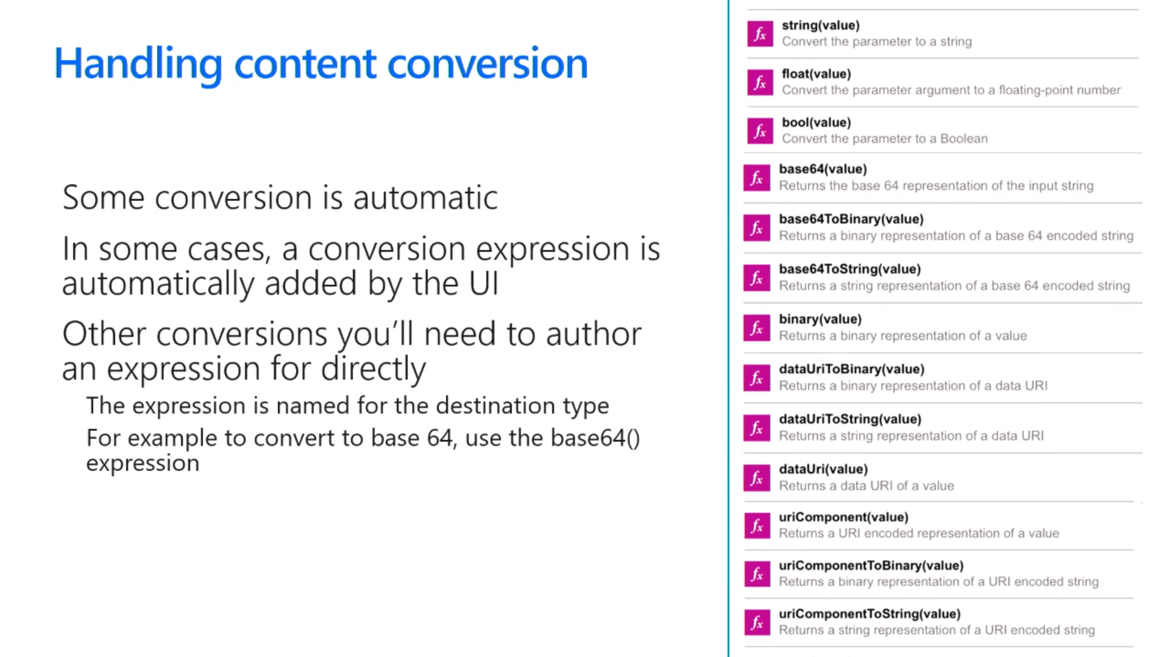
Handling Type Conversion
Some conversion is automatic
Sometimes conversions are performed for you
In other cases, you must explicitly convert between types

Slide 23
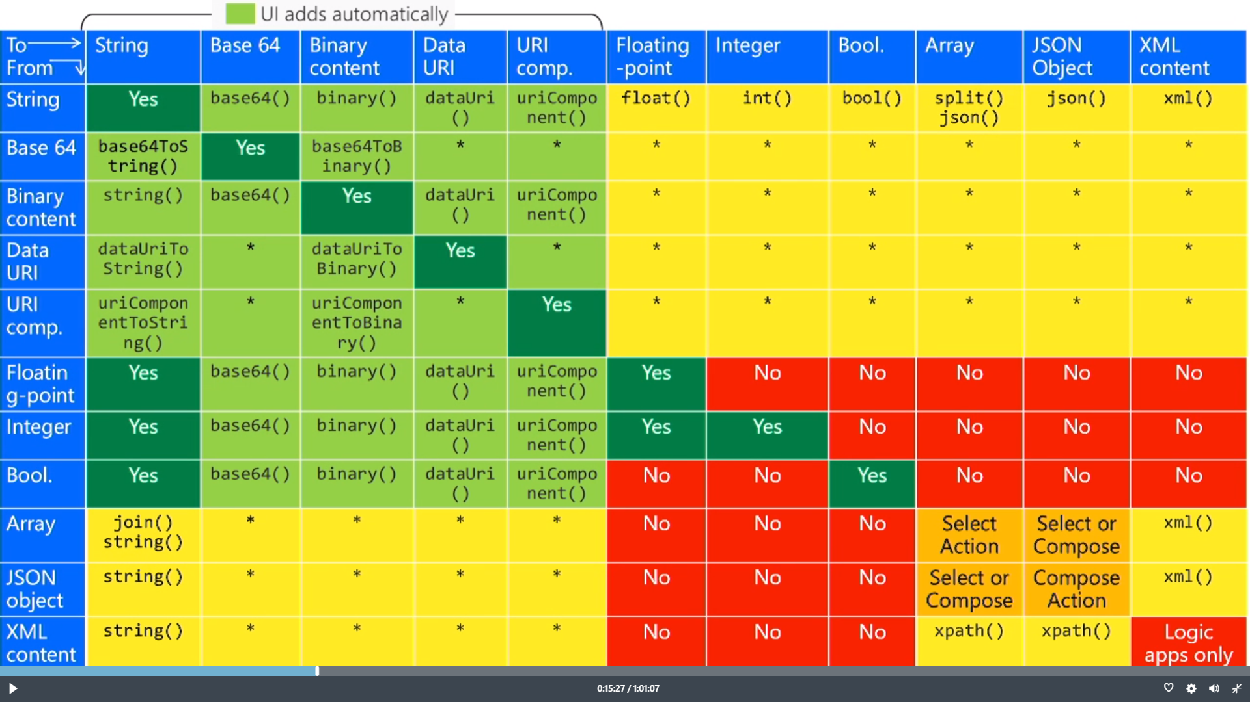
Flow Type Conversion Matrix

Slide 24
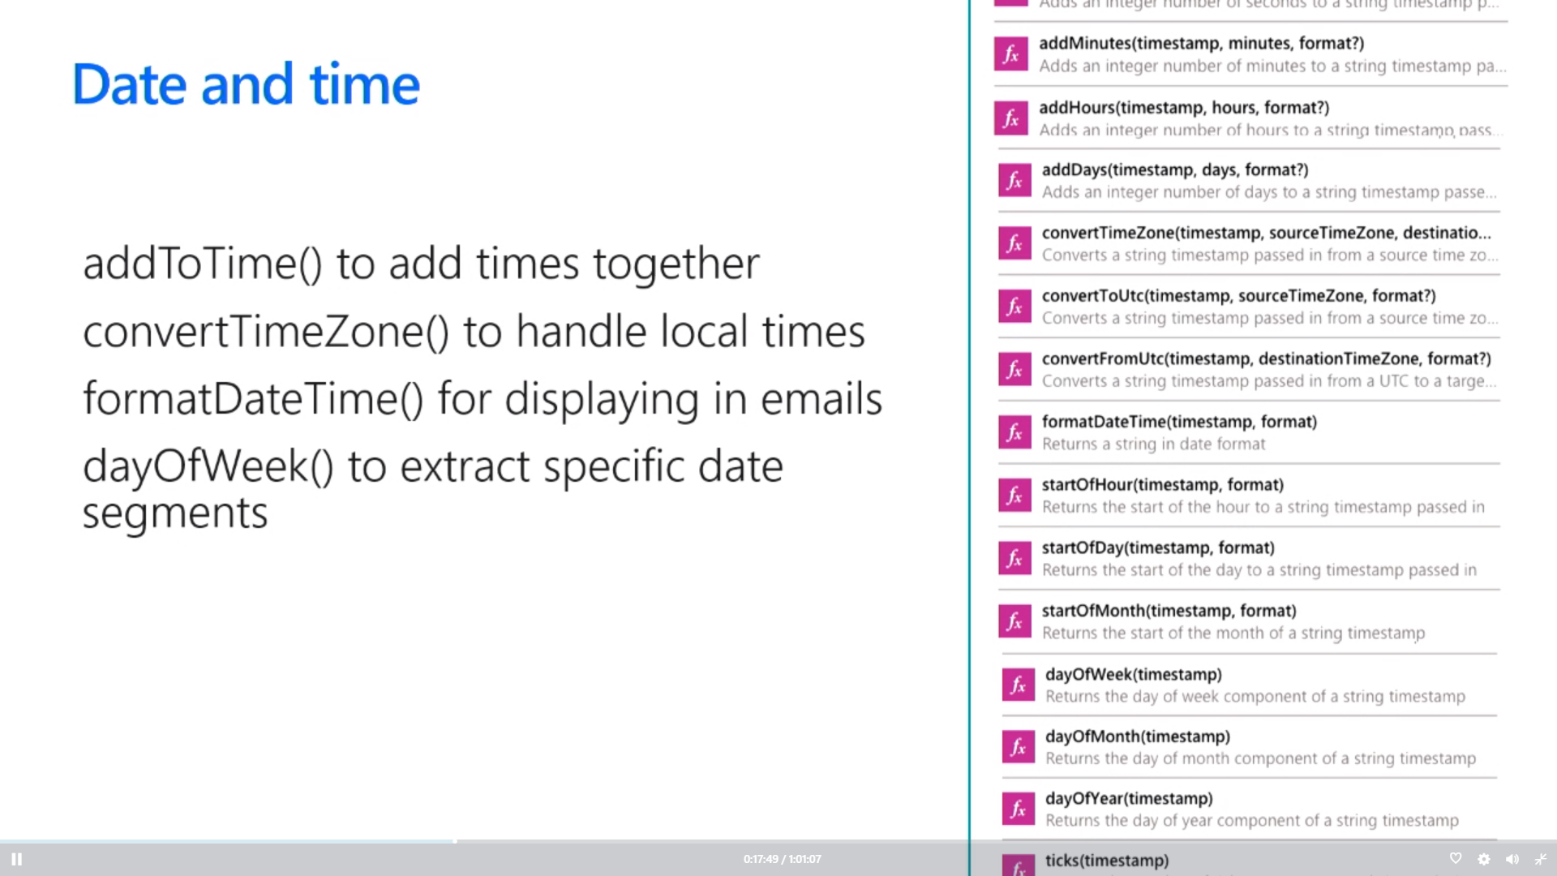
Working with Dates and Time
Get Greenwich Meantime using utcnow()
Use add*() functions to move time back/forward
convertTimeZone() used to handle local times
formatDateTime() used to format

Slide 25
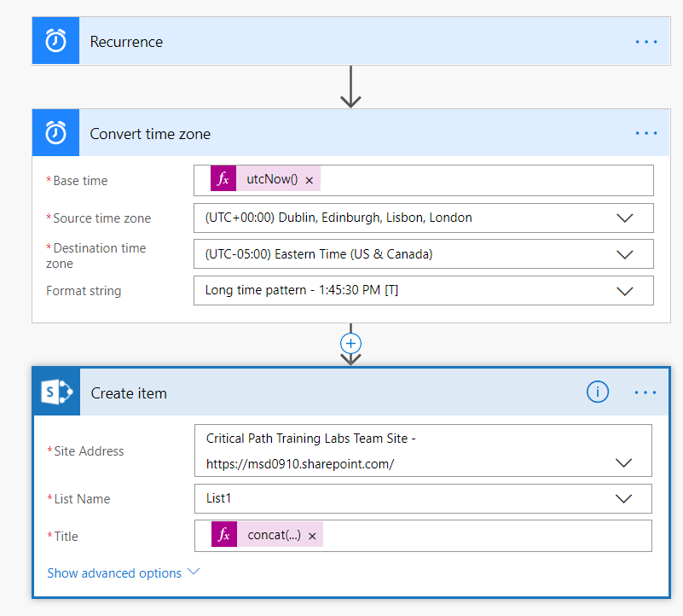
Using Convert time zone

Slide 26
Agenda
Flow Fundamentals
Writing Flow Expressions
Converting Between Types
Working with Arrays
Advanced Techniques

Slide 27
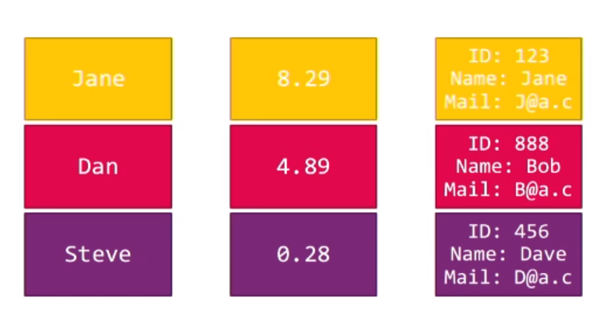
Working with Arrays in Flow
Scenarios for working with arrays
Repeat action of each item in SharePoint list
Retrieve single item from a list
Filter list items

Slide 28
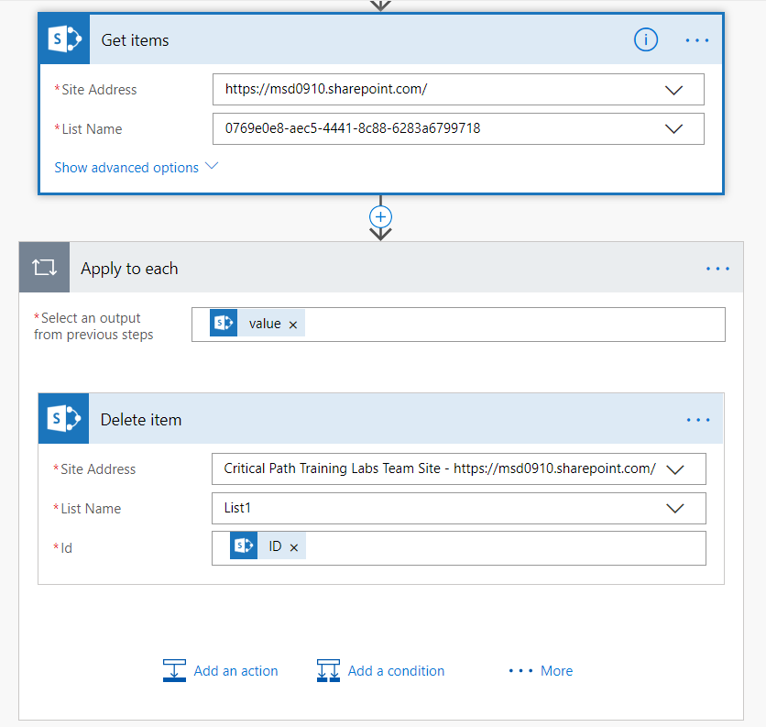
Using Apply to Each
Automatically added when list is used from output
Destination step enumerates over list items

Slide 29
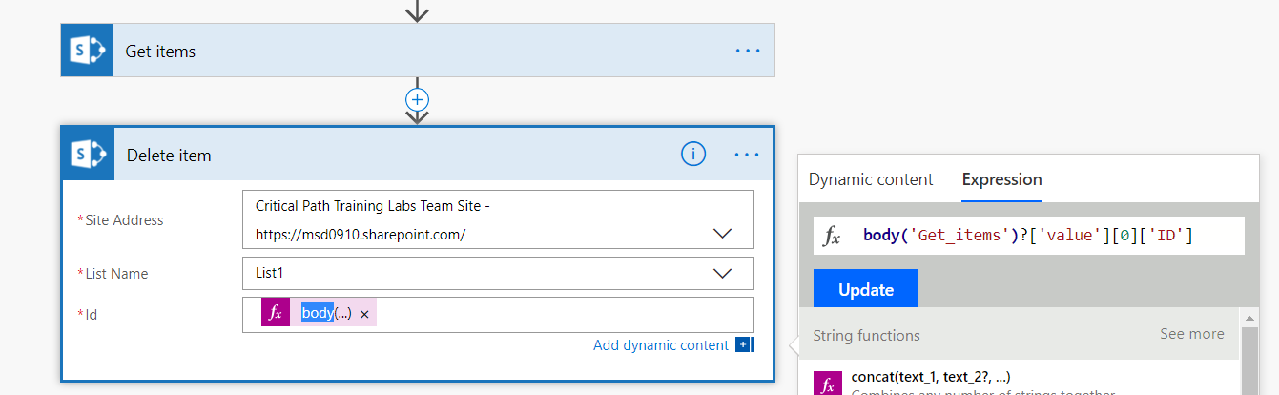
Retrieving List Items
Use first() and last() to get lead at head or tail
Individual items retrieved using zero-based array syntax
String array - body('Get_items')?[0]
SharePoint list - body('Get_items')?['value'][0]['ID']

Slide 30
Convert a List to a String
Join
- Use join for simple tasks such as combining email
Use must work with string array and not an object array
Create HTML/CSV Table
Convert list of objects into tabular display format

Slide 31
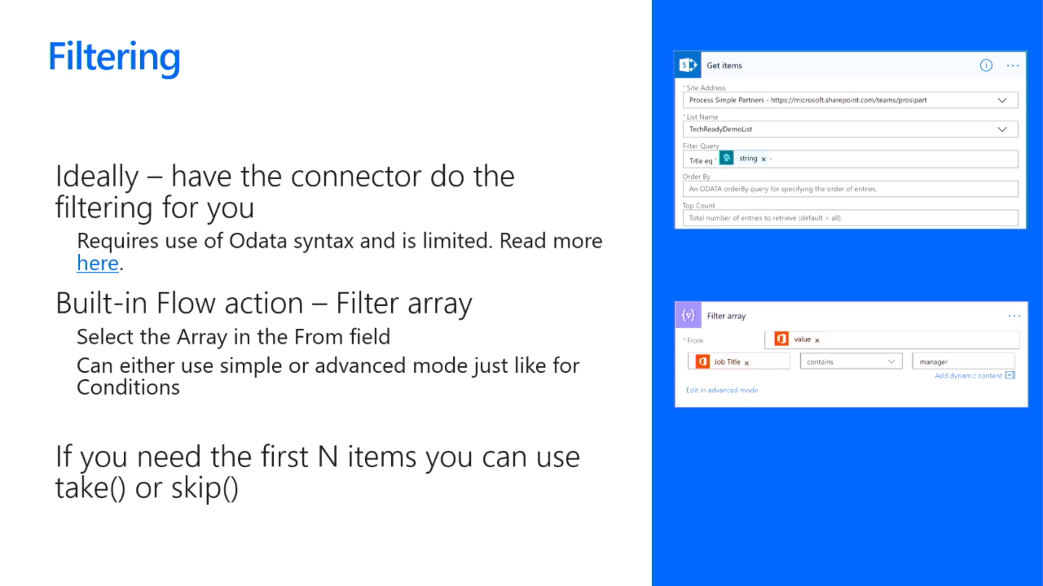
Filtering
Best to have connect perform filtering
Often requires use of OData query string parameters
There is also a built-in Flow action named Filter array
Select the Array in the From field
Can use simple or advanced mode just like in condition
If you need the first N items, use take() and skip()

Slide 32
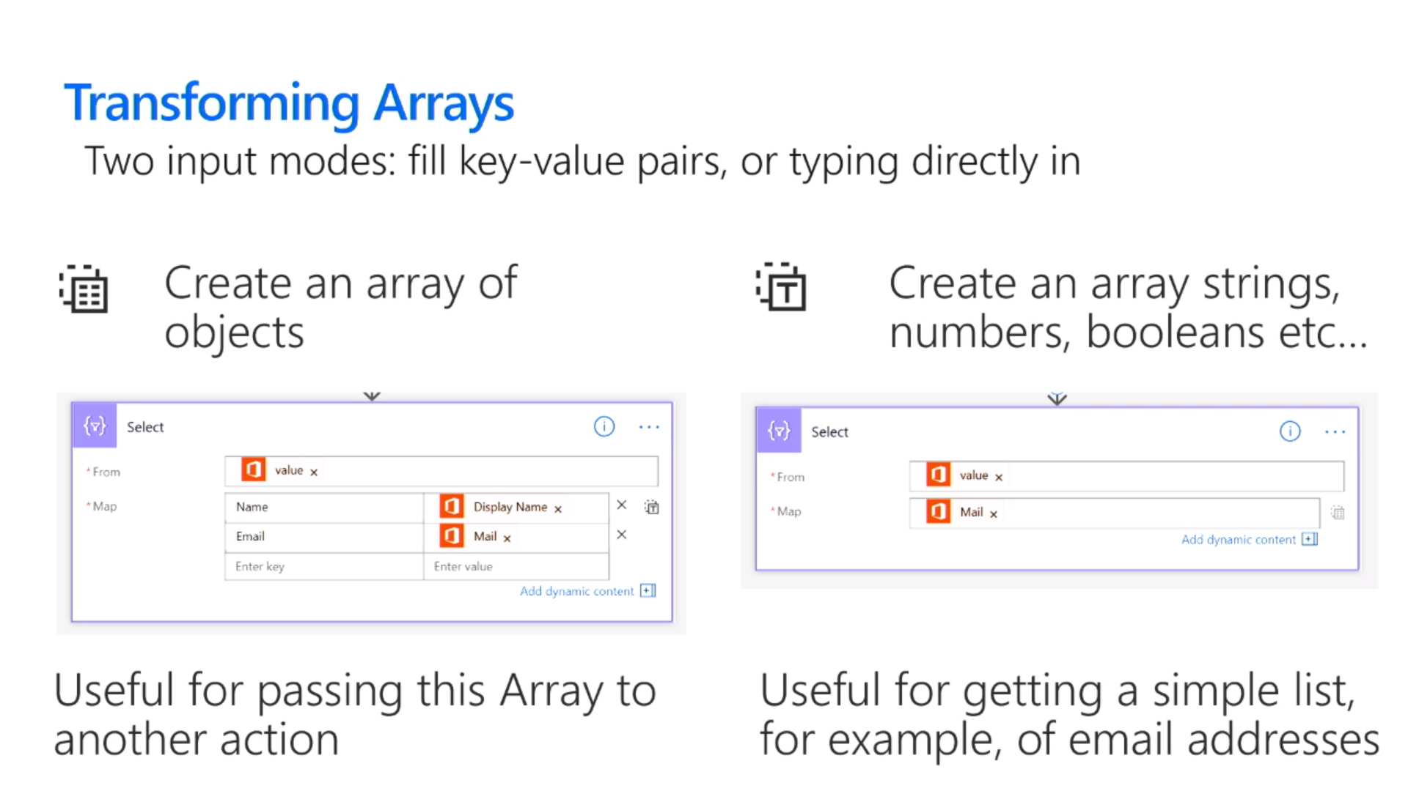
Transforming Arrays
Use Select action
Two input modes: fill key-value pairs or typing directly
Create array object objects
Useful for passing array to another action
Create a simple array of strings, numbers, Booleans, etc
Useful for creating simple list (e.g. email addresses)

Slide 33
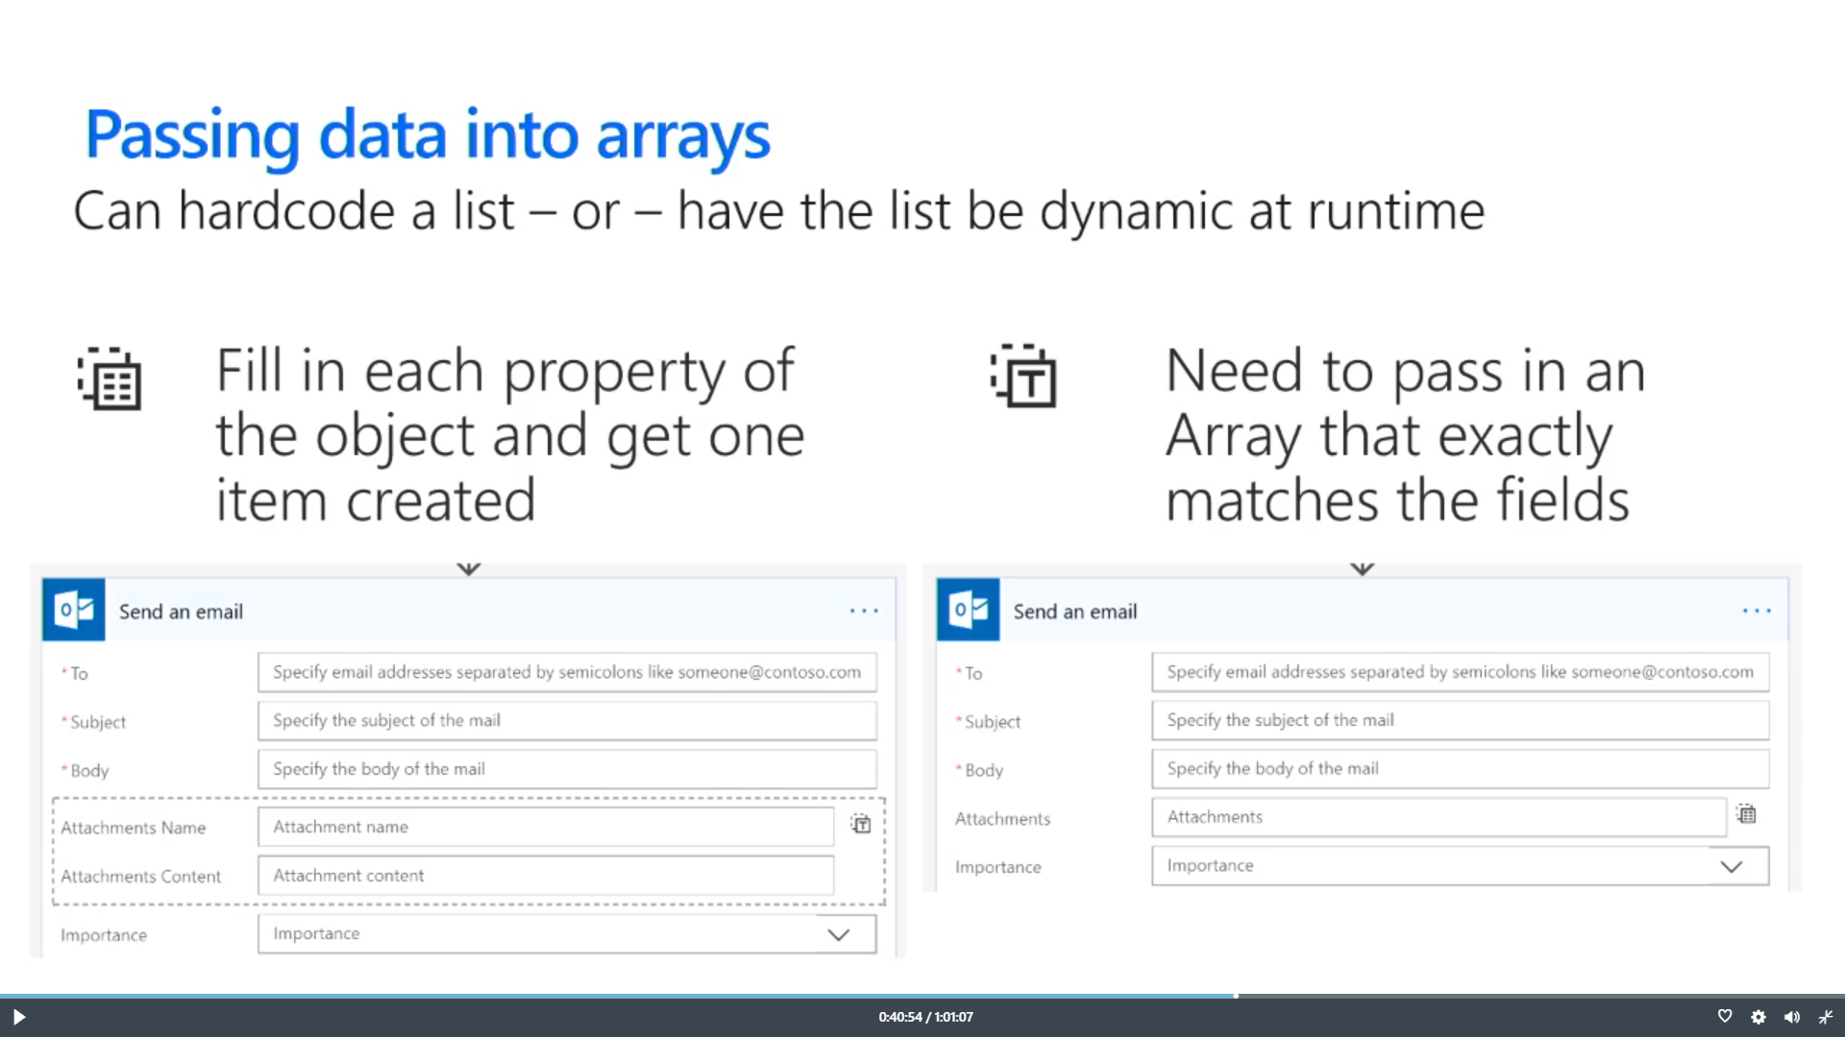
Passing Data into Arrays
Two options to pass data to an array
Hardcode list into an action
Create list dynamically at runtime
Fill in each property of object and get one item created
Need to pass in an Array that exactly matches the fields

Slide 34
Checking List Containment or Duplicates
You can use contains() to check if something is in array
You can use union() with array twice to get unique items

Slide 35
Agenda
Flow Fundamentals
Writing Flow Expressions
Converting Between Types
Working with Arrays
Advanced Techniques

Slide 36
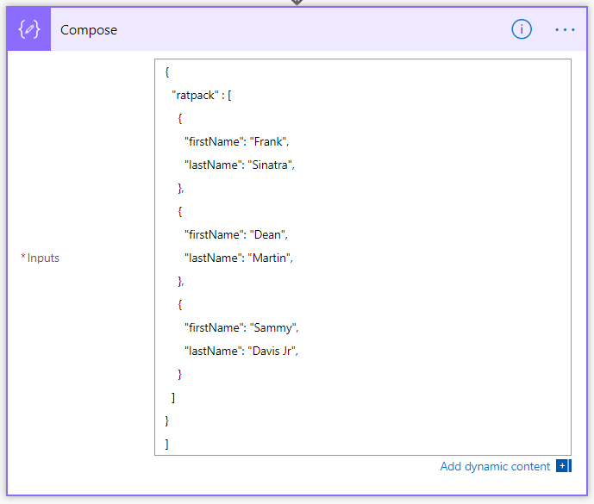
Building object directly
You can use Compose action to create object or array

Slide 37
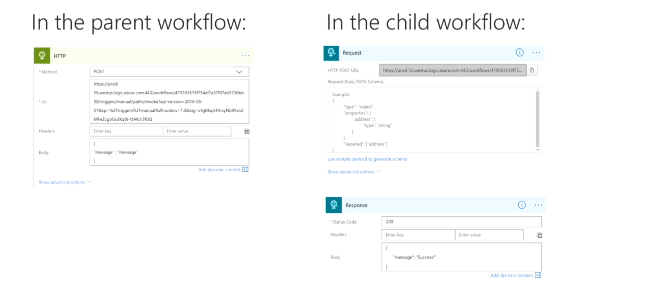
Calling Flows using the HTTP action

Slide 38
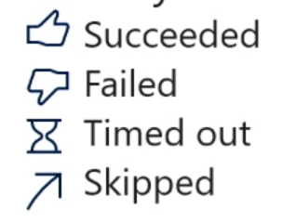
Normal action execution
Standard behavior of a flow
Action steps execute in sequential order
Flow terminates if error occurs (failure or timeout)
After flow runs, every action is in 1 of 4 possible states

Slide 39
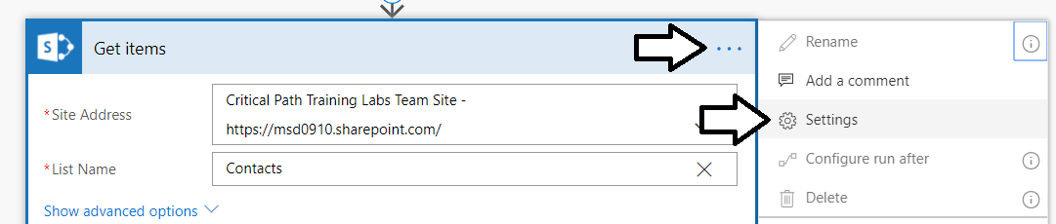
Action Settings
Settings let you configure
Async Actions
Timeouts
Retry Policy
Sequential Behavior
And more!

Slide 40
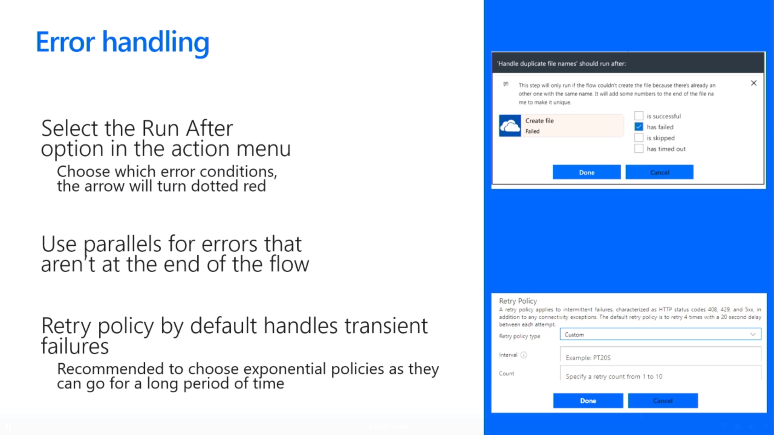
Error Handling
Select the Run after option from action menu
Choose which error conditions, the arrow will turn dotted red
Use parallels for errors that are not at end of flow
Retry policy by default handles transient failures
Recommended to select exponential as they last a long time

Slide 41
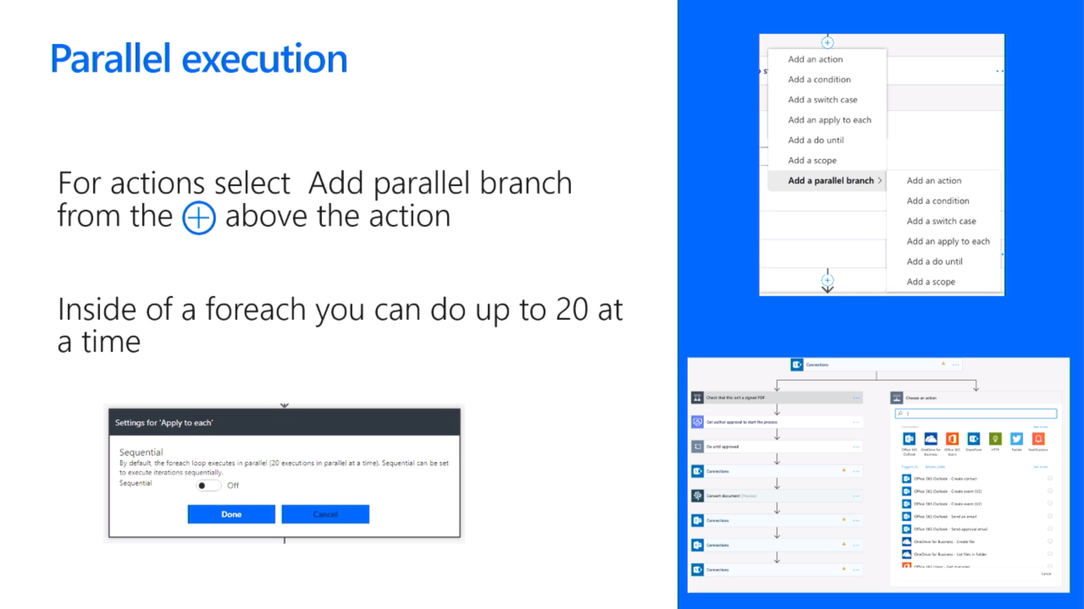
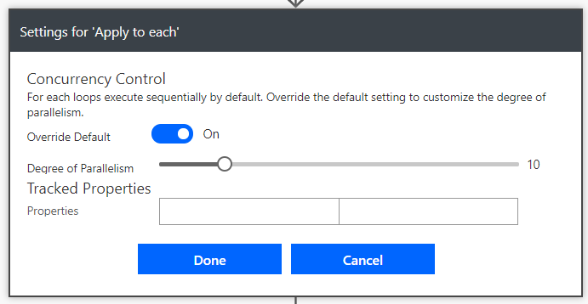
Parallel Execution
Add parallel branch from above using +
Apply to each is sequential by default
Adding parallel execute to Apply to each

Slide 42
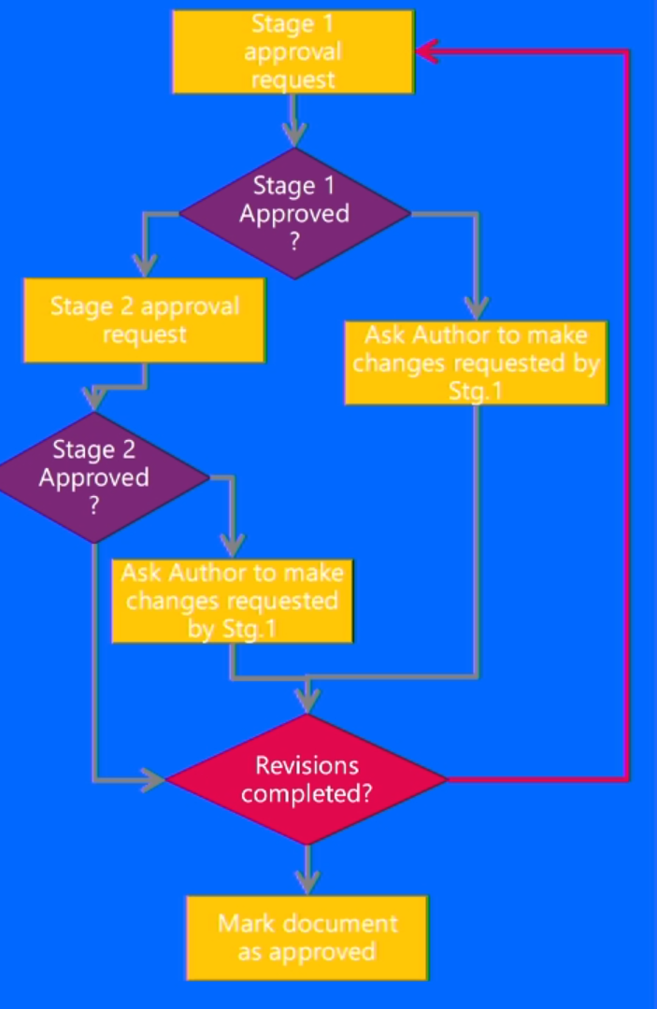
Looping
Do until actions
Provides loop until a condition becomes true
Useful when implementing approval process

Slide 43
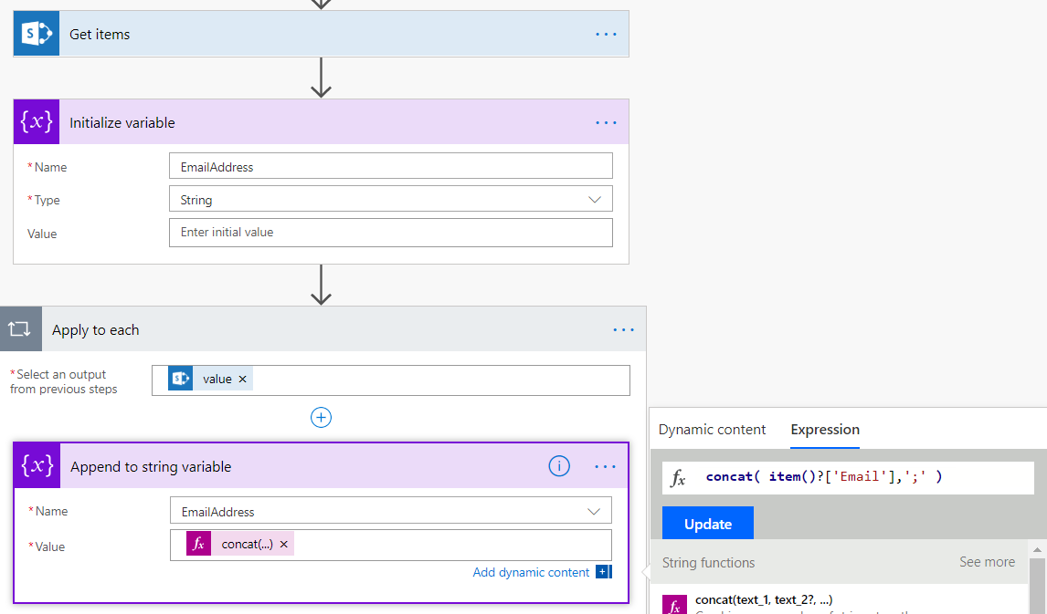
Variables
Using variables
Always define the variable type and initialize it
Used for counters and Boolean conditions
Useful to append content in to strings & arrays

Slide 44
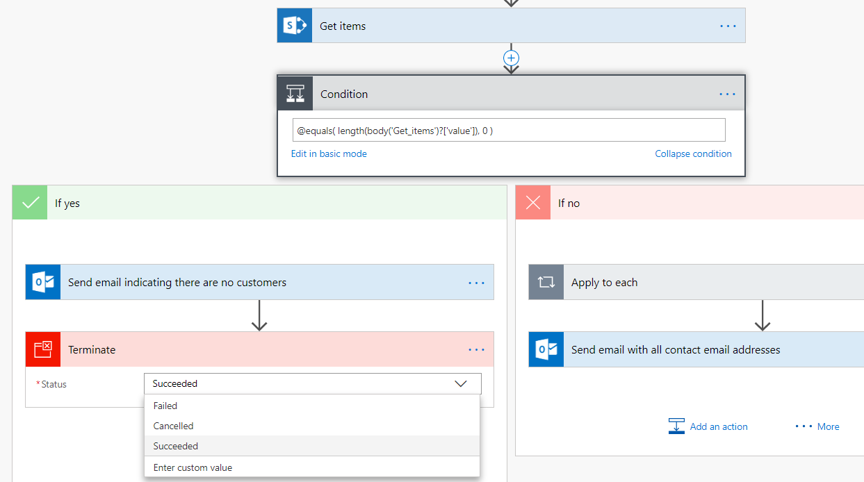
Terminate action
Used to stop a flow at any point
Terminate status can be set to Succeeded, Cancelled, Failed

Slide 45
Summary
Flow Fundamentals
Writing Flow Expressions
Converting Between Types
Working with Arrays
Advanced Techniques

Slide 46
Deep Dive into PowerApps and Flow
Two action-packed days of building PowerApps and Flows
Getting Started with PowerApps Studio
Designing PowerApps using Advanced Techniques
Building PowerApps for SharePoint Online
Introduction to Microsoft Flow
Designing Flows to Automate an Approval Process
Building PowerApps and Flows for Power BI
Working with the Common Data Service for Apps
Managing Application Lifecycle with PowerApps and Flow
More info
https://www.criticalpathtraining.com
info@criticalpathtraining.com

